Slide 1
Design and Analysis of Algorithms
CS345A
Lecture 39
Approximation Algorithms - II

Slide 2
RECAP OF the Last Lecture

Slide 3


A discrete math gem
Let $j_{1}$, $j_{2}$,…, $j_{ℓ}$ be any arbitrary $ℓ$positive integers such that
$$\sum_{t=1}^{t=ℓ}{j_{t}}≤m$$
What is a bound on
$$\frac{j_{1}}{m}+ \frac{j_{2}}{m−j_{1}}+\frac{j_{3}}{m−j_{1}−j_{2}}+…+\frac{j_{ℓ}}{m−j_{1}−j_{2}−…−j_{ℓ−1}}$$
$$≤1$$

Slide 4





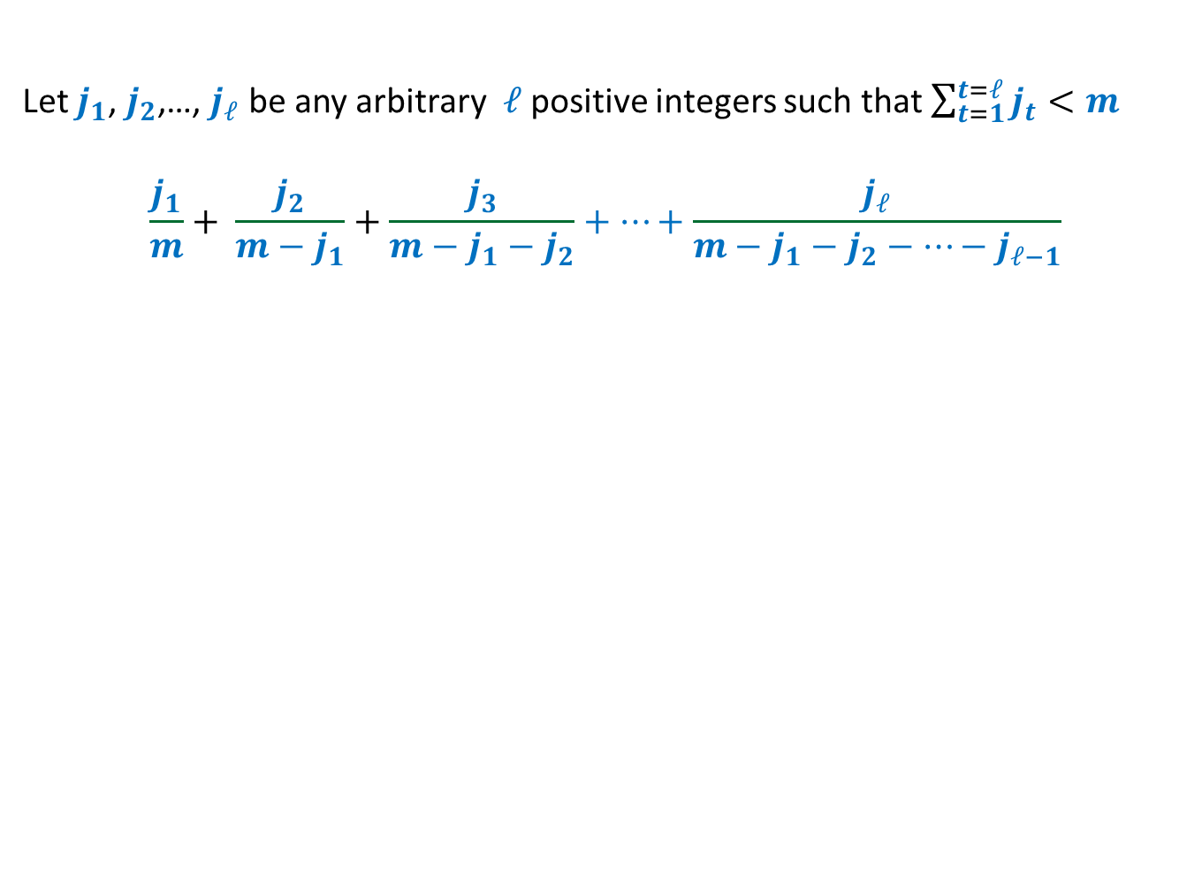








Let $j_{1}$, $j_{2}$,…, $j_{ℓ}$ be any arbitrary $ℓ$positive integers such that $\sum_{t=1}^{t=ℓ}{j_{t}}<m$
$$\frac{j_{1}}{m}+ \frac{j_{2}}{m−j_{1}}+\frac{j_{3}}{m−j_{1}−j_{2}}+…+\frac{j_{ℓ}}{m−j_{1}−j_{2}−…−j_{ℓ−1}}$$
$$≤log m$$
Relate the pink rectangles with the terms in the expression.
$$f\left(x\right)=1/x$$
$$\frac{1}{m−j_{1}−j_{2}−j_{3}}$$
$$\frac{1}{m−j_{1}−j_{2}}$$
$$\frac{1}{m−j_{1}}$$
$$\frac{1}{m}$$
$$j_{3}$$
$$j_{2}$$
$$j_{1}$$
$$m−j_{1}−j_{2}−j_{3}$$
$$m−j_{1}−j_{2}$$
$$m−j_{1}$$
$$m$$

Slide 5
Set Cover Problem

Slide 6
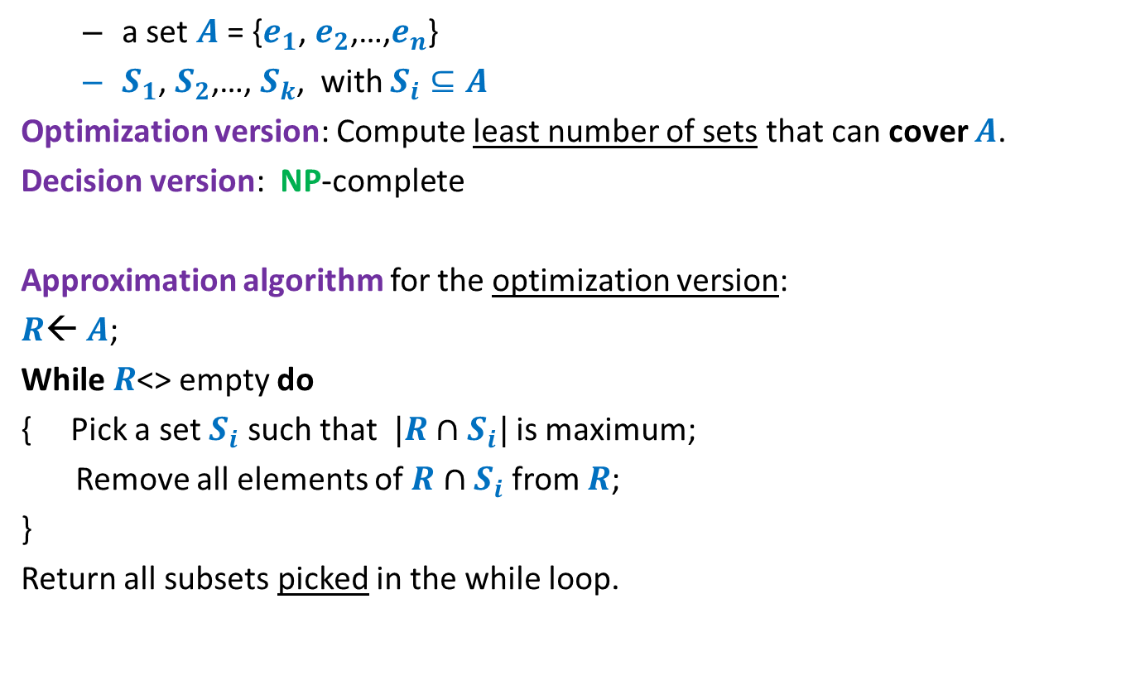
Set Cover Problem
a set $A$= {$e_{1}$, $e_{2}$,…,$e_{n}$}
$S_{1}$, $S_{2}$,…, $S_{k}$, with $S_{i}⊆A$
Optimization version: Compute least number of sets that can cover $A$.
Decision version: NP-complete
Approximation algorithm for the optimization version:
$R$← $A$;
While $R$<> empty do
{ Pick a set $S_{i}$ such that $|R∩S_{i}|$ is maximum;
Remove all elements of $R∩S_{i}$ from $R$;
}
Return all subsets picked in the while loop.
Homework

Slide 7










Optimality of the Greedy algorithm
a set $A$= {$e_{1}$, $e_{2}$,…,$e_{n}$}
$S_{1}$, $S_{2}$,…, $S_{k}$, with $S_{i}⊆A$
$$e_{8}$$
$$e_{2}$$
$$e_{7}$$
$$e_{5}$$
$$e_{9}$$
$$e_{1}$$
$$e_{3}$$
$$e_{6}$$
$$e_{4}$$

Slide 8
Optimality of the Greedy algorithm
a set $A$= {$e_{1}$, $e_{2}$,…,$e_{n}$}
$S_{1}$, $S_{2}$,…, $S_{k}$, with $S_{i}⊆A$
$$e_{8}$$
$$e_{2}$$
$$e_{7}$$
$$e_{5}$$
$$e_{9}$$
$$e_{1}$$
$$e_{3}$$
$$e_{6}$$
$$e_{4}$$

Slide 9
Optimality of the Greedy algorithm
a set $A$= {$e_{1}$, $e_{2}$,…,$e_{n}$}
$S_{1}$, $S_{2}$,…, $S_{k}$, with $S_{i}⊆A$
$$e_{8}$$
$$e_{2}$$
$$e_{7}$$
$$e_{5}$$
$$e_{9}$$
$$e_{1}$$
$$e_{3}$$
$$e_{6}$$
$$e_{4}$$

Slide 10

Optimality of the Greedy algorithm
a set $A$= {$e_{1}$, $e_{2}$,…,$e_{n}$}
$S_{1}$, $S_{2}$,…, $S_{k}$, with $S_{i}⊆A$
Greedy solution has $3$ sets
$$e_{8}$$
$$e_{2}$$
$$e_{7}$$
$$e_{5}$$
$$e_{9}$$
$$e_{1}$$
$$e_{3}$$
$$e_{6}$$
$$e_{4}$$

Slide 11




Optimality of the Greedy algorithm
a set $A$= {$e_{1}$, $e_{2}$,…,$e_{n}$}
$S_{1}$, $S_{2}$,…, $S_{k}$, with $S_{i}⊆A$
➔ Approx. ratio for this instance:
$$3/2$$
Greedy solution has $3$ sets
What is the worst case approx. ratio guaranteed for every possible instance ?
Optimal solution has $2$ sets
$$e_{8}$$
$$e_{2}$$
$$e_{7}$$
O($log n$)
$$e_{5}$$
$$e_{9}$$
$$e_{1}$$
$$e_{3}$$
$$e_{6}$$
$$e_{4}$$
We shall establish this approx. ratio for even the generic problem.

Slide 12
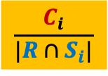
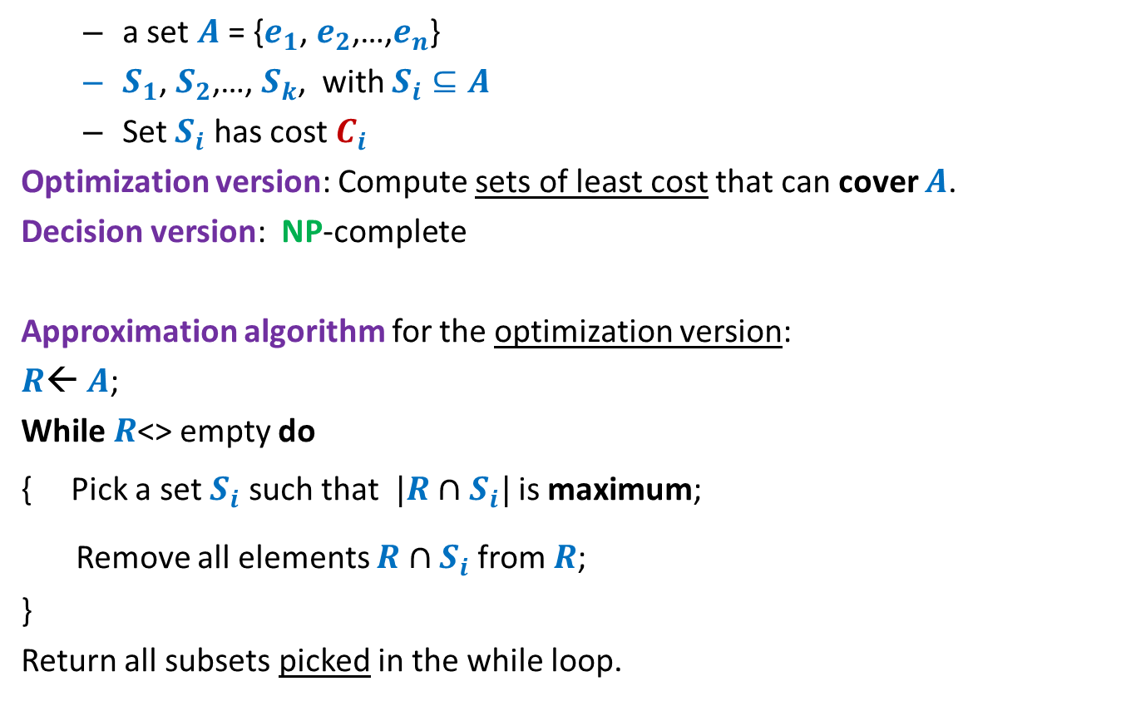
Set Cover Problem
Generic
a set $A$= {$e_{1}$, $e_{2}$,…,$e_{n}$}
$S_{1}$, $S_{2}$,…, $S_{k}$, with $S_{i}⊆A$
Set $S_{i}$ has cost $C_{i}$
Optimization version: Compute sets of least cost that can cover $A$.
Decision version: NP-complete
Approximation algorithm for the optimization version:
$R$← $A$;
While $R$<> empty do
{ Pick a set $S_{i}$ such that $|R∩S_{i}|$ is maximum;
Remove all elements $R∩S_{i}$ from $R$;
}
Return all subsets picked in the while loop.
$$\frac{C_{i}}{|R∩S_{i}|}$$
is minimum;

Slide 13
How to analyze the greedy algorithm ?
The challenge:
No knowledge of the optimal solution.
Aim to get a worst case guarantee for all possible instances.
Conquering the challenge:
Pick any arbitrary instance
“Compare” greedy solution with its optimal solution.

Slide 14













How to analyze the greedy algorithm ?
Question: How to account for the sets $s_{2}$, $s_{6}$, $s_{11}$in the greedy algorithm ?
the sets belonging to “Optimal” solution
Optimal solution
$$s_{1}$$
$$s_{2}$$
$$s_{3}$$
$$s_{4}$$
$$s_{5}$$
$$s_{6}$$
$$s_{7}$$
$$s_{8}$$
$$s_{9}$$
$$s_{10}$$
$$s_{11}$$
$$s_{12}$$
Greedy solution
but absent in “Greedy” solution

Slide 15
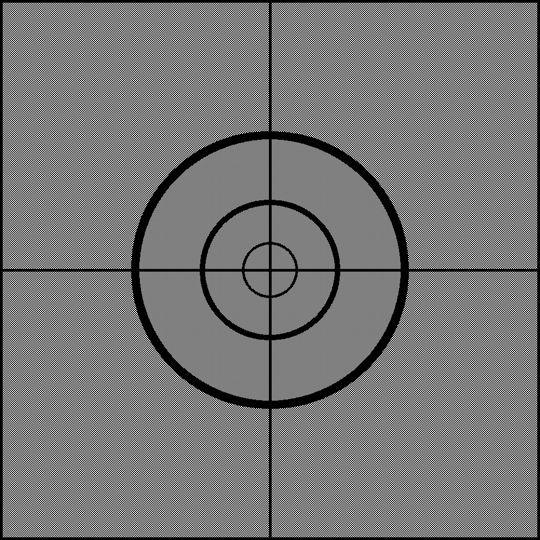
How to analyze the greedy algorithm ?
The key to analysis :
Cost of Sets
Cost of Elements

Slide 16

















Cost of each set ➔ cost of each element
Cost
Sets
Elements
$$e_{1}$$
$C_{1}$= $5$
$$s_{1}$$
$$e_{2}$$
$$e_{3}$$
$C_{2}$= $8$
$$s_{2}$$
$$e_{4}$$
$$e_{5}$$
$C_{3}$= $7$
$$s_{3}$$
$$e_{6}$$
$$e_{7}$$
$$e_{8}$$
$C_{4}$= $11$
$$s_{4}$$
$$e_{9}$$

Slide 17









Cost of each set ➔ cost of each element
Viewing any algorithm
Sum of cost of sets selected = sum of cost paid for each element.
Greedy algorithm: Select the set with ?
Cost
Sets
Elements
Cost/element
$$e_{1}$$
$$\frac{5}{4}$$
$C_{1}$= $5$
$$s_{1}$$
$$e_{2}$$
$$\frac{5}{4}$$
$$e_{3}$$
$$\frac{5}{4}$$
$C_{2}$= $8$
$$s_{2}$$
$$e_{4}$$
$$\frac{5}{4}$$
$$e_{5}$$
$$4$$
$C_{3}$= $7$
$$s_{3}$$
$$e_{6}$$
$$4$$
$$e_{7}$$
$$\frac{7}{3}$$
$$e_{8}$$
$$\frac{7}{3}$$
$C_{4}$= $11$
$$s_{4}$$
$$e_{9}$$
$$\frac{7}{3}$$
least cost per element

Slide 18



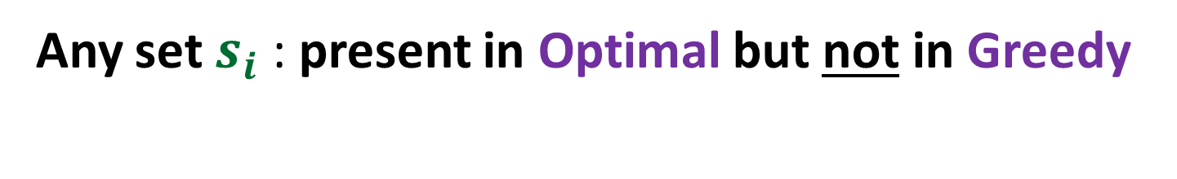
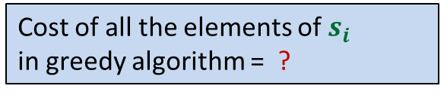


Any set $s_{i}$ : present in Optimal but not in Greedy
Cost =$C_{i}$
$$s_{i}$$
$|s_{i}|$ =$m_{i}$
Cost of these elements
in optimal algorithm = ?
Cost of all the elements of $s_{i}$
in greedy algorithm = ?
Cost of these elements
in greedy algorithm = ?
$$C_{i}$$
$${≤C}_{i} log m_{i}$$

Slide 19

The core of the analysis
Visualize the Greedy algorithm
from perspective of $s_{i}$

Slide 20
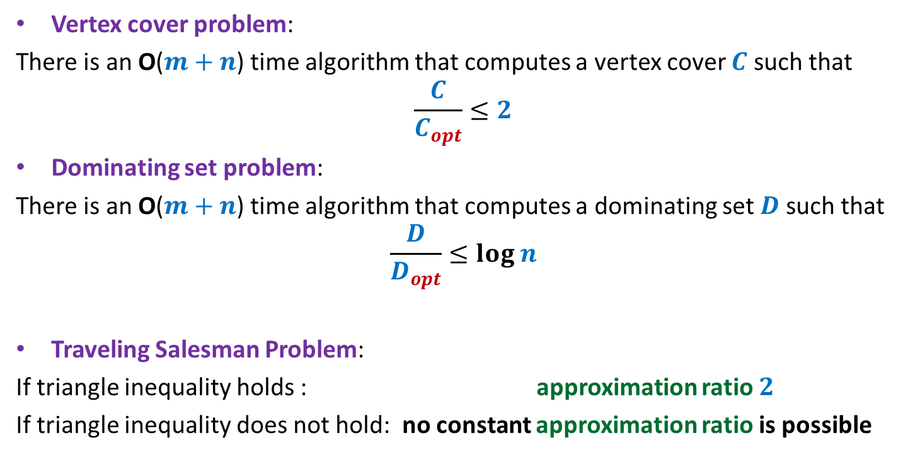


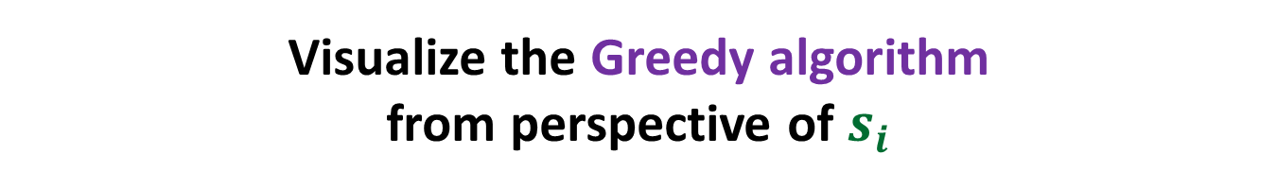

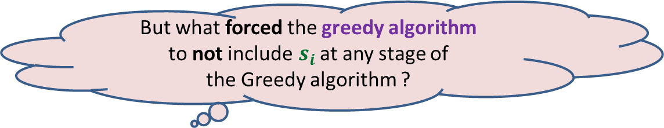




Visualize the Greedy algorithm from perspective of $s_{i}$
$$\sum_{k=1}^{k=ℓ}{j_{k}}=m_{i}$$
$$j_{1}$$
$$j_{2}$$
Cost =$C_{i}$
$$s_{i}$$
$$j_{3}$$
$|s_{i}|$ =$m_{i}$
…
…
$$j_{ℓ}$$
But what forced the greedy algorithm
to not include$s_{i}$ at any stage of
the Greedy algorithm ?
There was always another set that offered
“same or better cost per element” ☺

Slide 21





$$\sum_{k=1}^{k=ℓ}{j_{k}}=m_{i}$$
Cost of first $j_{1}$elements covered by greedy = ?
Cost of next $j_{2}$elements covered by greedy = ?
Cost of next $j_{3}$elements covered by greedy = ?
Cost of last $j_{ℓ}$elements covered by greedy = ?
$$j_{1}$$
$$j_{2}$$
Cost =$C_{i}$
$$s_{i}$$
$$j_{3}$$
$|s_{i}|$ =$m_{i}$
…
…
$$j_{ℓ}$$
$$≤\frac{C_{i}}{m_{i}}j_{1}$$
$$≤\frac{C_{i}}{m_{i}−j_{1}}j_{2}$$
$$≤\frac{C_{i}}{m_{i}−j_{1}−j_{2}}j_{3}$$
$$≤\frac{C_{i}}{m_{i}−j_{1}−j_{2}−…−j_{ℓ−1}}j_{ℓ}$$

Slide 22

$$\sum_{k=1}^{k=ℓ}{j_{k}}=m_{i}$$
Cost of covering all elements of $s_{i}$ by greedy =
$$≤\frac{C_{i}}{m_{i}}j_{1}+ \frac{C_{i}}{m_{i}−j_{1}}j_{2}+\frac{C_{i}}{m_{i}−j_{1}−j_{2}}j_{3}+…+\frac{C_{i}}{m_{i}−j_{1}−j_{2}−…−j_{ℓ−1}}j_{ℓ}$$
$$≤C_{i}\left(\frac{j_{1}}{m_{i}}+ \frac{j_{2}}{m_{i}−j_{1}}+\frac{j_{3}}{m_{i}−j_{1}−j_{2}}+…+\frac{j_{ℓ}}{m_{i}−j_{1}−j_{2}−…−j_{ℓ−1}}\right)$$
$≤C_{i} log m_{i}$
$$j_{1}$$
$$j_{2}$$
Cost =$C_{i}$
$$s_{i}$$
$$j_{3}$$
…
…
$$j_{ℓ}$$

Slide 23
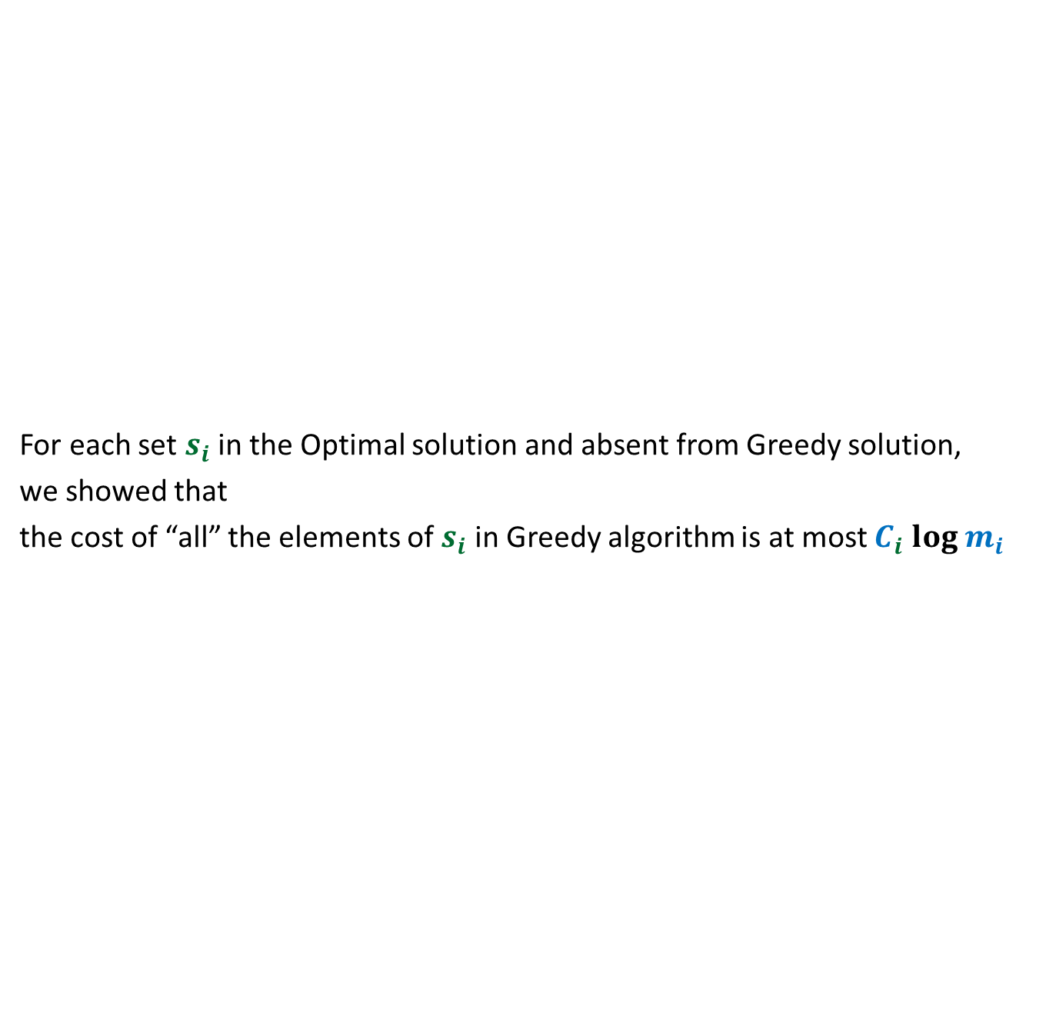
What have we established ?
For each set $s_{i}$in the Optimal solution and absent from Greedy solution,
we showed that
the cost of “all” the elements of $s_{i}$ in Greedy algorithm is at most $C_{i} log m_{i}$
Optimal solution
$$s_{1}$$
$$s_{2}$$
$$s_{3}$$
$$s_{4}$$
$$s_{5}$$
$$s_{6}$$
$$s_{7}$$
$$s_{8}$$
$$s_{9}$$
$$s_{10}$$
$$s_{11}$$
$$s_{12}$$
Greedy solution

Slide 24
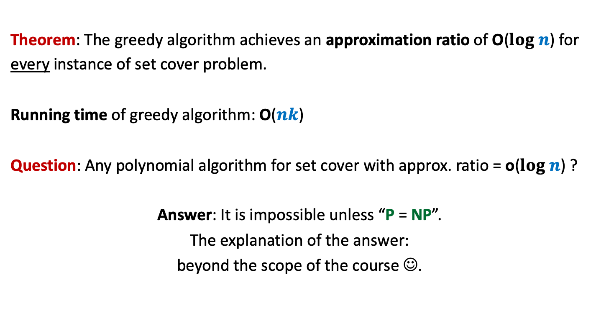
Conclusion
Theorem: The greedy algorithm achieves an approximation ratio of O($log n$) for
every instance of set cover problem.
Running time of greedy algorithm: O($nk$)
Question: Any polynomial algorithm for set cover with approx. ratio = o($log n$) ?
Answer: It is impossible unless “P = NP”.
The explanation of the answer:
beyond the scope of the course ☺.

Slide 25
Think of the following memorable Problem
If you ever doubt the area of algorithm and its role in real world problem

Slide 26

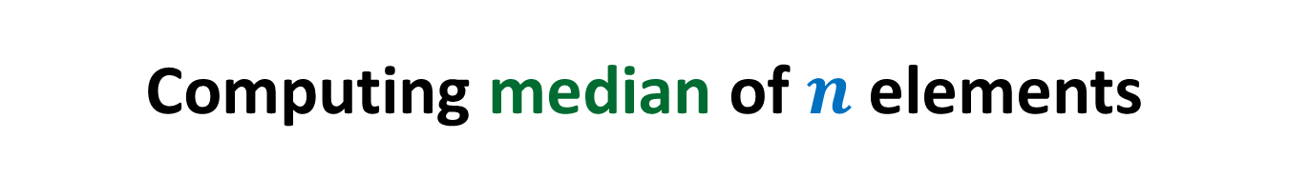


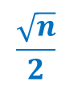

Computing median of $n$ elements
RAM size= $Θ(\sqrt{n})$
Algorithm | No. of scans
O($n$)
$$\frac{\sqrt{n}}{2}$$
Exercise
Assignment
O($\log{n}$)
Novel
$$2$$
Optimal

Slide 27



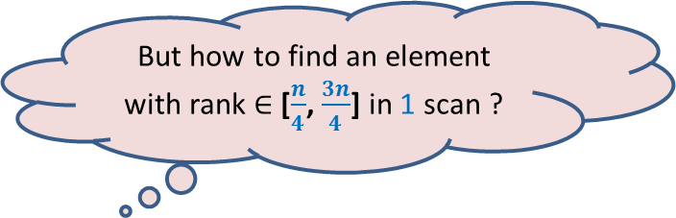
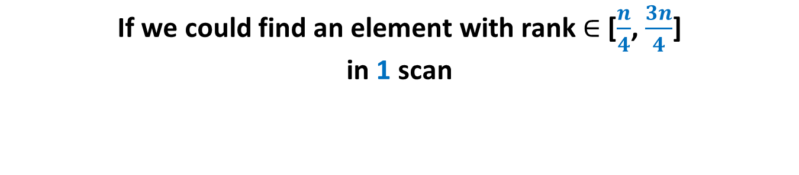

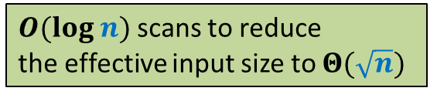




If we could find an element with rank $∈$ [$\frac{n}{4}$, $\frac{3n}{4}$] in 1 scan
RAM size= $Θ(\sqrt{n})$
RAM
Effective input size
$$412$$
Rank $=\frac{n}{3}$
$$\frac{2n}{3}$$
$$\frac{4n}{9}$$
But how to find an element with rank $∈$ [$\frac{n}{4}$, $\frac{3n}{4}$] in 1 scan ?
$$\frac{8n}{27}$$
$$<412$$
$O(log n)$scans to reduce
the effective input size to $Θ(\sqrt{n})$
$$412$$
Disc

Slide 28


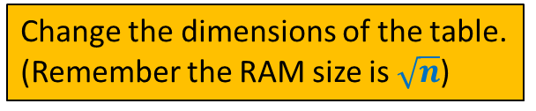

Median of medians algorithm
Recall your DS course
Element with rank $∈$ [$\frac{3n}{10}$, $\frac{7n}{10}$]
$$\frac{n}{5}$$
$$5$$
How to make use of it to solve the current problem ?
Change the dimensions of the table.
(Remember the RAM size is $\sqrt{n}$)

Slide 29



Median of medians algorithm
Recall your DS course
Element with rank $∈$ [$\frac{n}{4}$, $\frac{3n}{4}$]
$$\sqrt{n}$$
$$\sqrt{n}$$

Slide 30

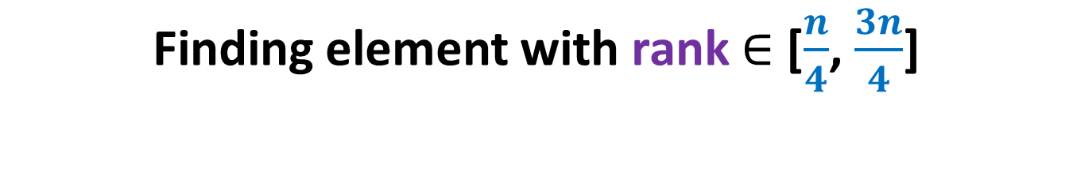
Finding element with rank $∈$ [$\frac{n}{4}$, $\frac{3n}{4}$]
RAM size= $Ω(\sqrt{n})$
RAM
Disc

Slide 31
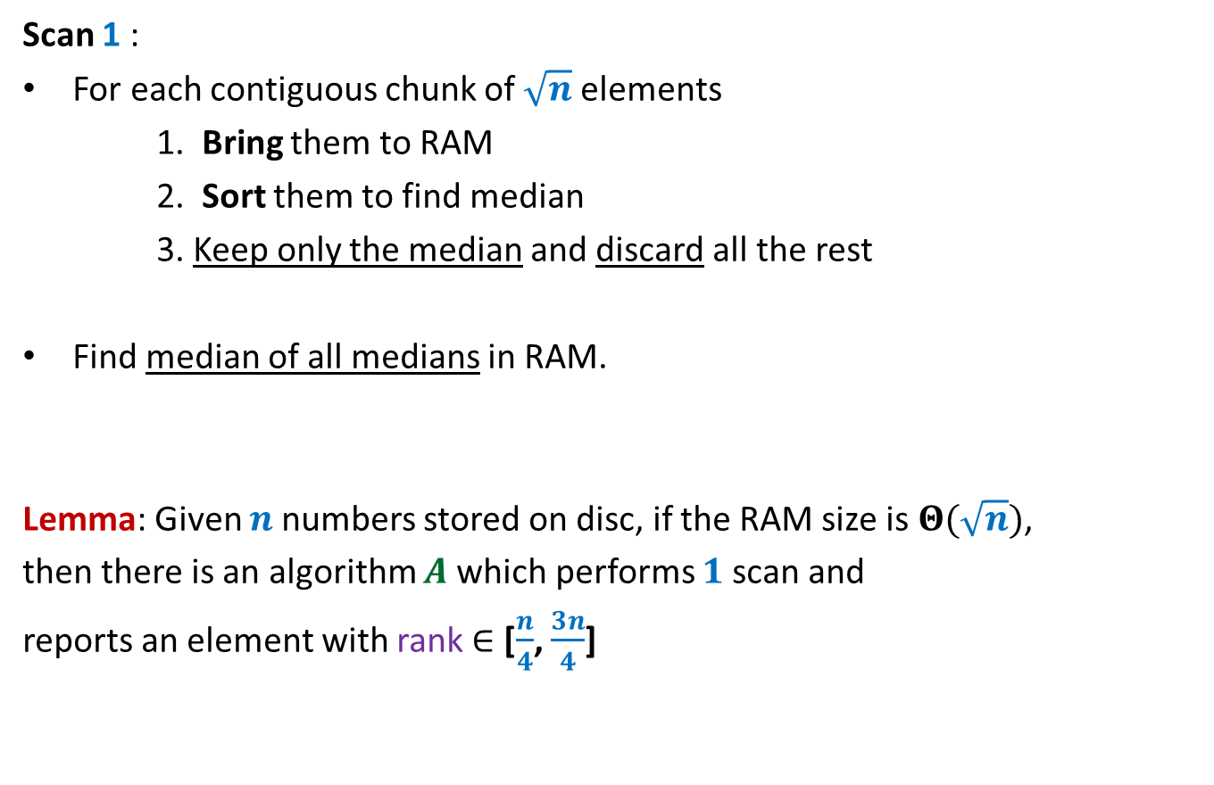
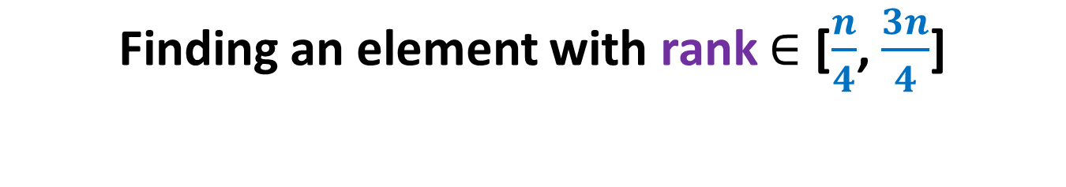
Finding an element with rank $∈$ [$\frac{n}{4}$, $\frac{3n}{4}$]
Scan 1 :
For each contiguous chunk of $\sqrt{n}$ elements
1. Bring them to RAM
2. Sort them to find median
3. Keep only the median and discard all the rest
Find median of all medians in RAM.
Lemma: Given $n$numbers stored on disc, if the RAM size is $Θ(\sqrt{n})$,
then there is an algorithm $A$which performs $1$scan and
reports an element with rank $∈$ [$\frac{n}{4}$, $\frac{3n}{4}$]

Slide 32
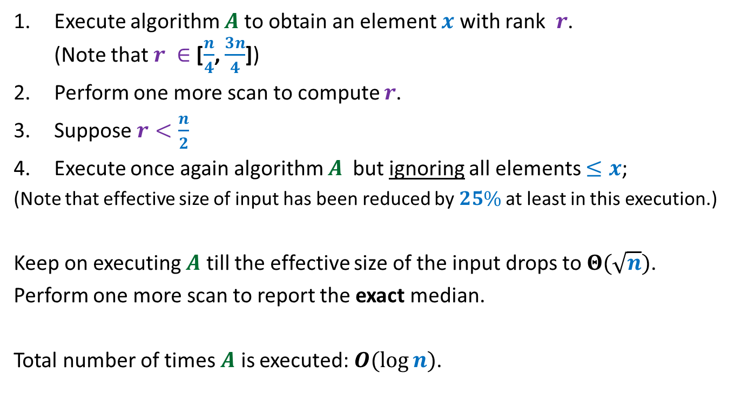
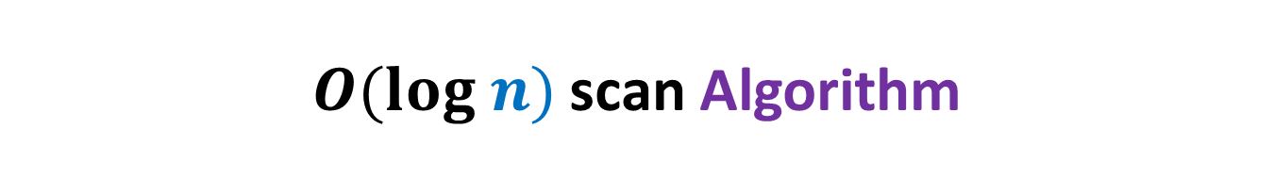
$O(log n)$scan Algorithm
Execute algorithm $A$to obtain an element $x$ with rank $r$. (Note that $r ∈$ [$\frac{n}{4}$, $\frac{3n}{4}$])
Perform one more scan to compute $r$.
Suppose $r<\frac{n}{2}$
Execute once again algorithm $A$ but ignoring all elements $≤x$;
(Note that effective size of input has been reduced by $25\%$ at least in this execution.)
Keep on executing $A$ till the effective size of the input drops to $Θ(\sqrt{n})$.
Perform one more scan to report the exact median.
Total number of times $A$ is executed: $O(\log{n})$.

Slide 33
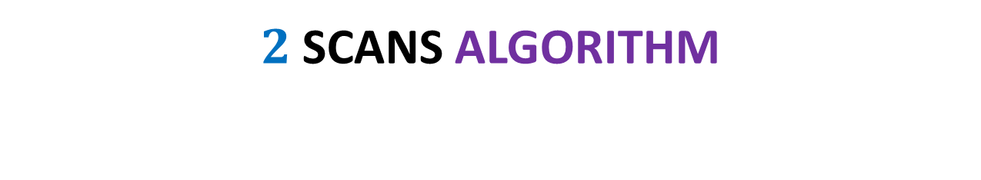
$2$SCANs Algorithm
Deterministic algorithm
Randomized algorithm
Heavy algorithm and complex analysis
A light algorithm with elegant analysis

Slide 34


